Slide 1
Service Oriented All Around Us
Service Oriented Architecture
Lecture 2
Dr. Alessio Bonti
Notes:
Good morning , my name is alessio bonti
Today I will talk about “from commonuties to Blockchain sharing economies”

Slide 2
SOA Definition
Businesses provide services, therefore they are service oriented.

Slide 3

SOA
When we integrate this “service orientation” into an architecture, we obtain a service oriented architecture.
It serves the purpose by strategically position units of solution logic
Collectively, they comprise a larger piece of automation logic.
Notes:
So This is my current research focus, both scientifically and also from an industry persespecitve

Slide 4
In short SOA is
A distributed technology model with distinct characteristics in support to create service orientation
Notes:
Want to use block chain
To redefine trust
In order to empower people
To reinvent economies

Slide 5
Let’s imagine an enterprise architecture….
Imagine if applications were standalone
Imagine the orange part is redundant in all…
The impact would be extremely wasteful
A
B
C
20%
30%
15%
Essentially we are running the same code over and over.
Notes:
First something about me
I spent 8 years studying at Deakin and I currently work for IBM Research
I am a research software engineer and among things I contriubte to scientific activities, patens , develop software and lead client engagements

Slide 6
Enterprise without SOA
This makes it very difficult for the organization to grow
Growth of budge, resources allocation and size can become a huge drain on the overall organization.
Old Enterprise
This is just not scalable
Notes:
First something about me
I spent 8 years studying at Deakin and I currently work for IBM Research
I am a research software engineer and among things I contriubte to scientific activities, patens , develop software and lead client engagements

Slide 7
Object Orientation VS Services
A
B
C
If we look at the application model, object orientation suffers from being tightly coupled down to the logic.
Service composition allows instead for loosely coupled units, allowing for high level composition
Notes:
First something about me
I spent 8 years studying at Deakin and I currently work for IBM Research
I am a research software engineer and among things I contriubte to scientific activities, patens , develop software and lead client engagements

Slide 8
Example of Service Oriented
Independent Services
Translation
Voice To Text
Text To Speech
Conversation
Translation App
Conversation App
Application Implementations
Notes:
First something about me
I spent 8 years studying at Deakin and I currently work for IBM Research
I am a research software engineer and among things I contriubte to scientific activities, patens , develop software and lead client engagements

Slide 9
Service orientation Requirements
Automation logic is distributed into units
Loose coupling, no inter dependencies
Each unit can grow and evolve independently
Units maintain sufficient amount of commonality to allow interoperability
Notes:
Want to use block chain
To redefine trust
In order to empower people
To reinvent economies

Slide 10
Service orientation is a design paradigm
Intended for the creation of solution logic units.
Individually shaped for reutilization.
Solution Logic is designed in accordance with service orientation.
Units of service orientated logic are called services
Notes:
Want to use block chain
To redefine trust
In order to empower people
To reinvent economies

Slide 11
Fundamental Characteristics
Business Driven
The technology should always reflect the business, it was born to be part of it, therefore it needs continuous evolution
Vendor Neutral
Allow the technology to be independent and ensure longevity, this will also improve interoperability
Enterprise Centric
Supports agnostic services that are reused to participate in the automation of different business tasks and processes
Composition Centric
Being able to easily composed into new forms
Notes:
Want to use block chain
To redefine trust
In order to empower people
To reinvent economies

Slide 12
Principles – Wrap up
Loose Coupling – Services must be ‘aware’ of each other and not dependent on each other
Service Contract – Services must adhere to service descriptions
Autonomy – Services must control the logic they encapsulate
Abstraction – Services must hide the logic they implement
Reusability – Service separation should promote reuse
Composability – Collective services should be possible
Statelessness – Services must minimize the retaining of information specific to an activity
Discoverability – Services must be designed to be outwardly descriptive to allow discovery
Notes:
So This is my current research focus, both scientifically and also from an industry persespecitve

Slide 13
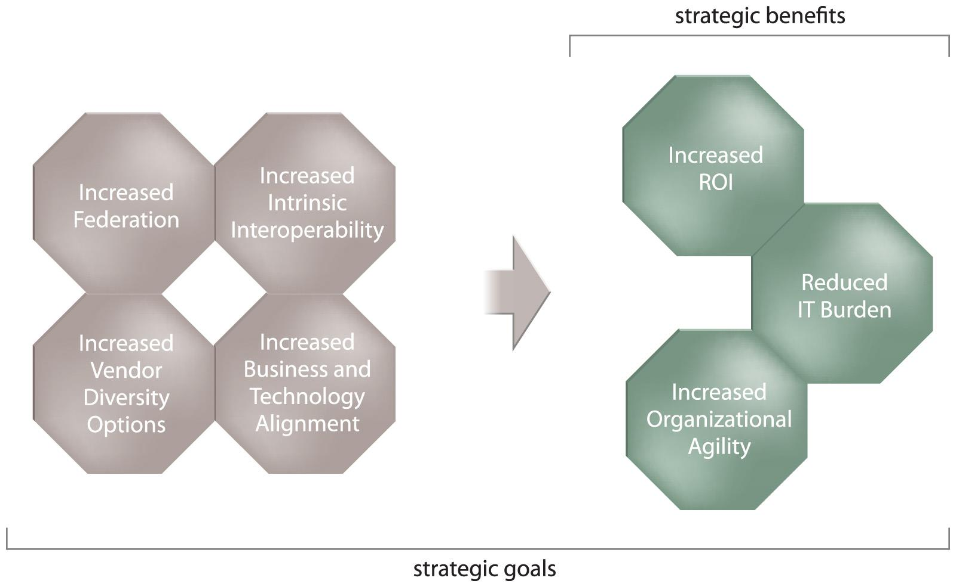
Strategic Goals and Benefits
Here are seven main goals, the strategic benefits are direct results of the first four being achieved
Notes:
Want to use block chain
To redefine trust
In order to empower people
To reinvent economies

Slide 14
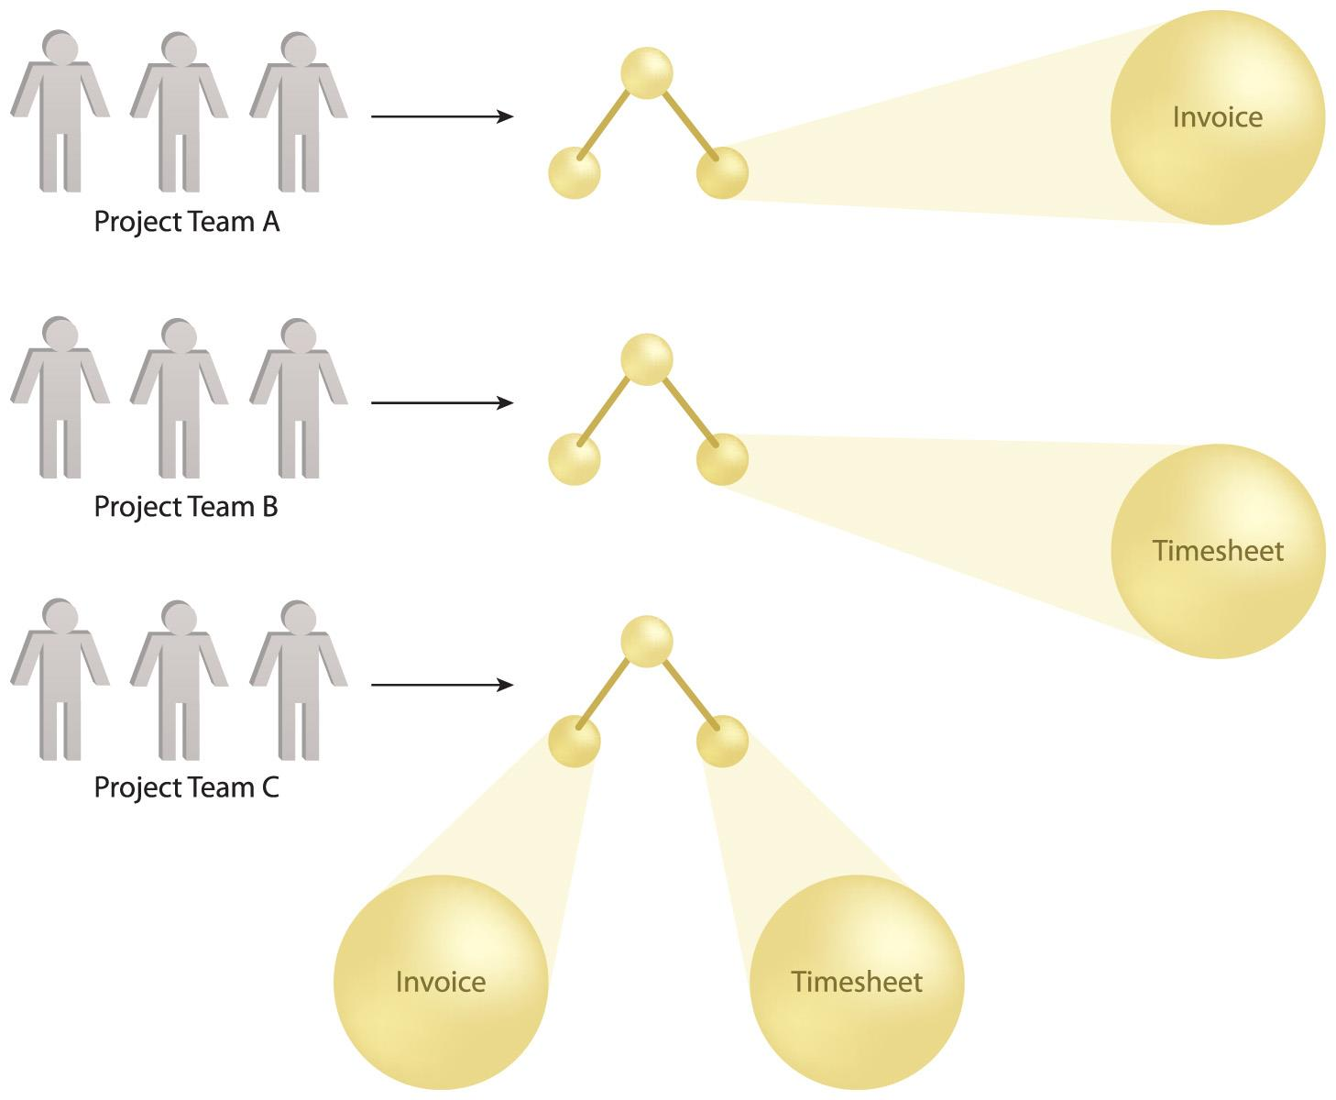
Intrinsic Operability
Services are designed to be intrinsically interoperable regardless of when and for which purpose they are delivered.
In this example, the intrinsic interoperability of the Invoice and Timesheet services delivered by Project Teams A and B allow them to be combined into a new service composition by Project Team C.
Notes:
First something about me
I spent 8 years studying at Deakin and I currently work for IBM Research
I am a research software engineer and among things I contriubte to scientific activities, patens , develop software and lead client engagements

Slide 15
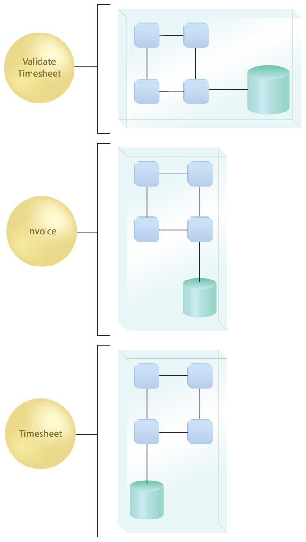
Increased Federation
Federated IT environment: Resources and applications are united while maintaining their individual autonomy
SOA increases federation through standardized and composable services
Example
Three service contracts establishing a federated set of endpoints, each of which encapsulates a different implementation.
Notes:
First something about me
I spent 8 years studying at Deakin and I currently work for IBM Research
I am a research software engineer and among things I contriubte to scientific activities, patens , develop software and lead client engagements

Slide 16
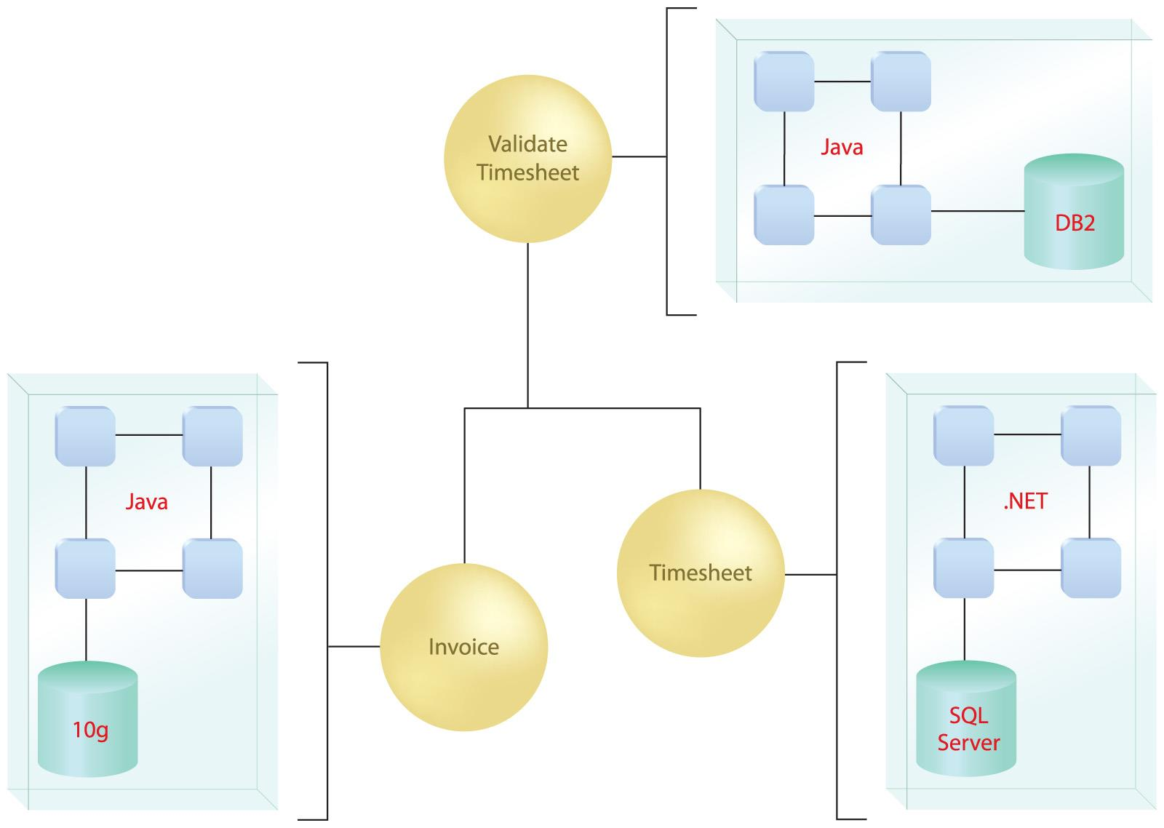
Increase Vendor Diversity
Implementation is independent, and hidden from the consumer.
We use strict inputs and outputs elaborated by what appears as a black box to the user.
Notes:
First something about me
I spent 8 years studying at Deakin and I currently work for IBM Research
I am a research software engineer and among things I contriubte to scientific activities, patens , develop software and lead client engagements

Slide 17
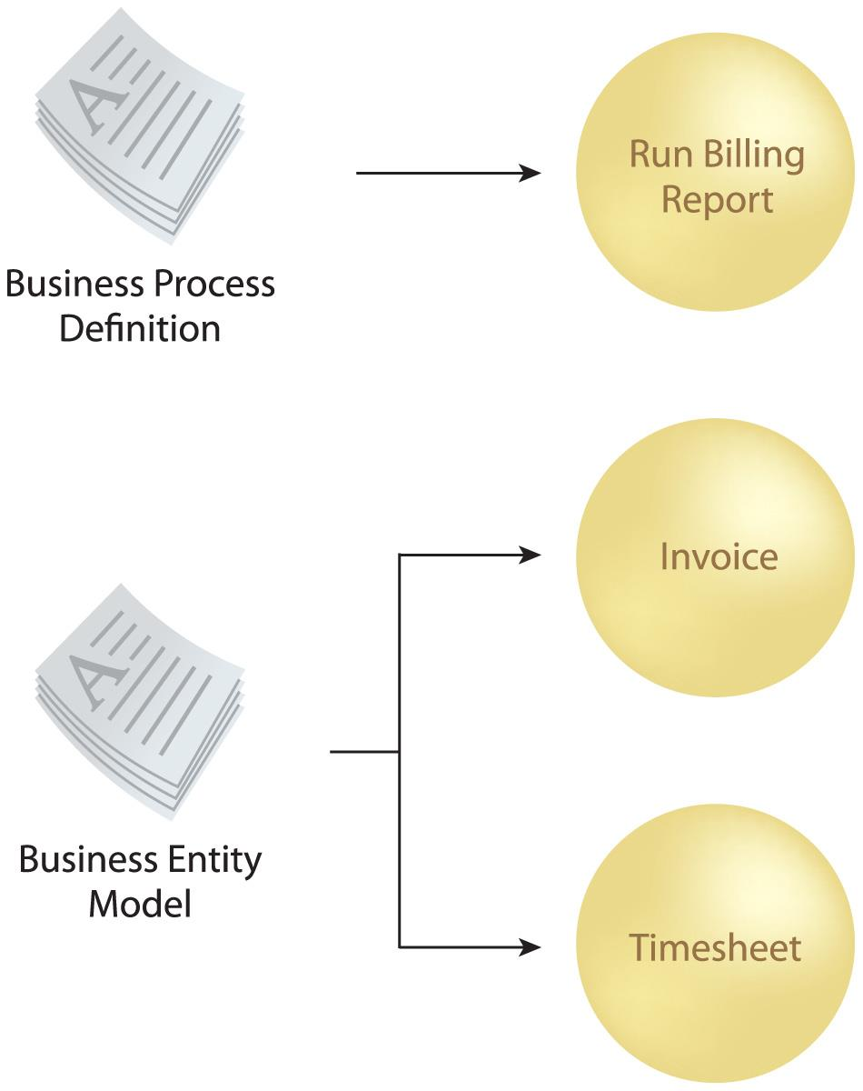
Increased Business and Technology Alignment
Services with business-centric functional contexts are carefully modeled to express and encapsulate corresponding business models and logic.
Once implemented, business models remains as a form of physical service
Notes:
First something about me
I spent 8 years studying at Deakin and I currently work for IBM Research
I am a research software engineer and among things I contriubte to scientific activities, patens , develop software and lead client engagements

Slide 18
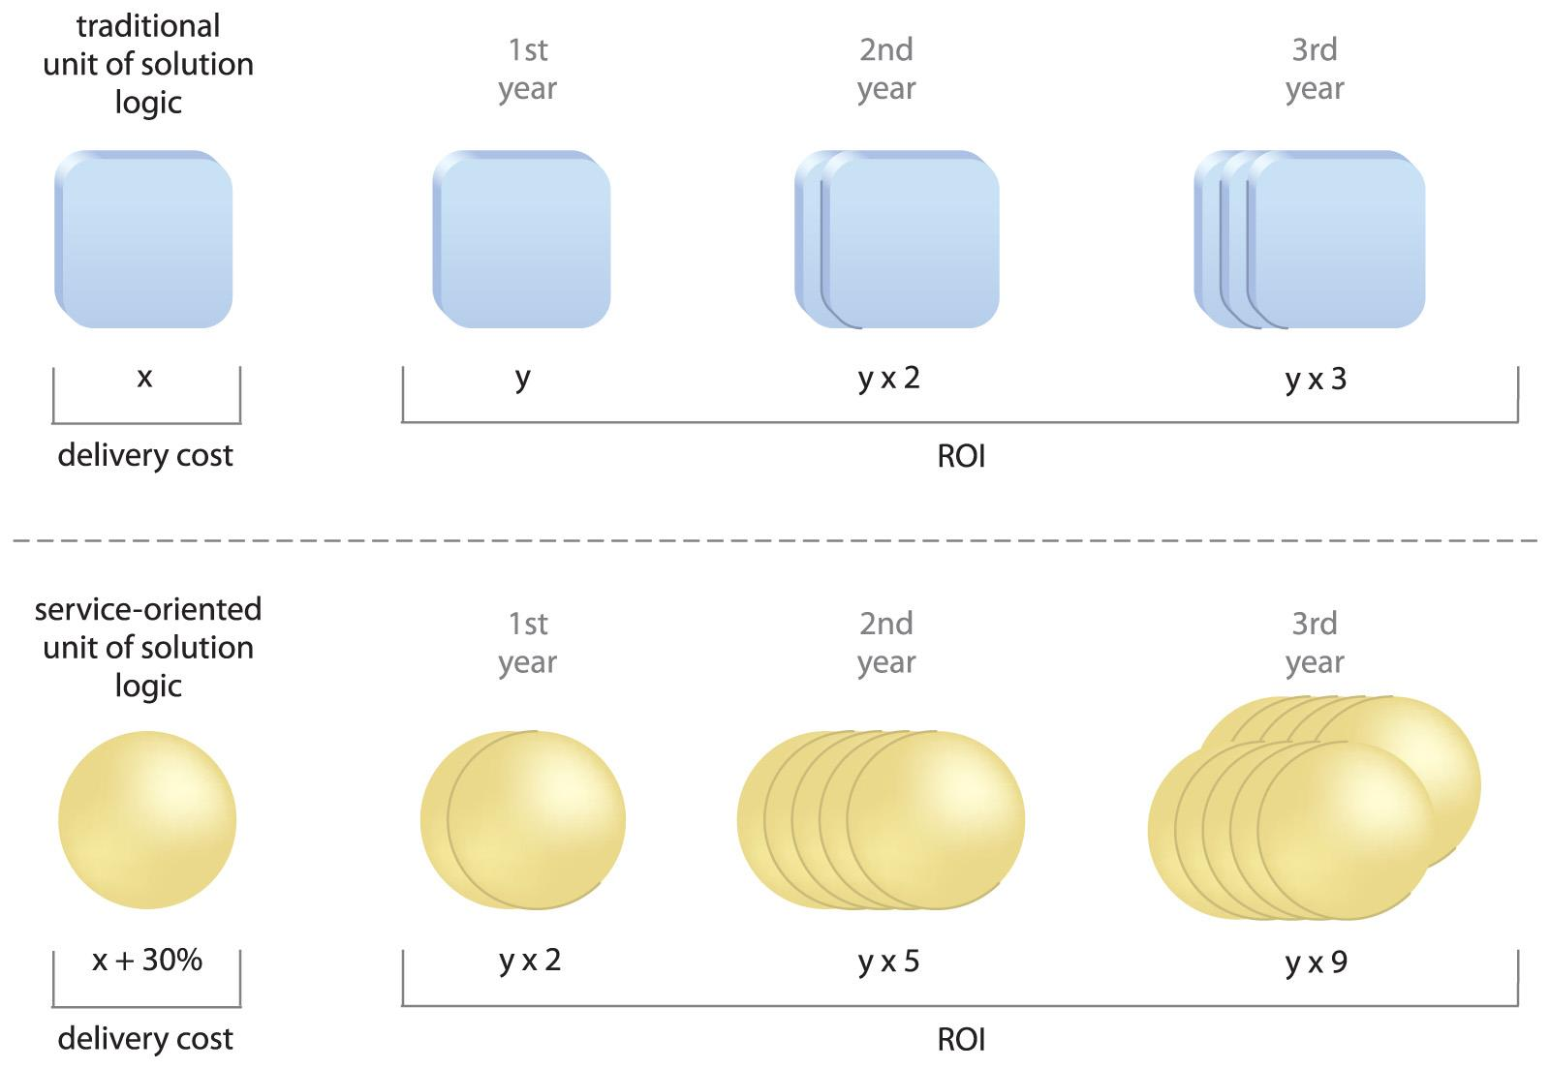
Increased Business and Technology Alignment
Any agnostic service can be repurposed many times to automate different business processes as part of SOA solution
Upfront expense is invested into every piece of solution considered as an IT assets for the purpose of repeatable
An example of the types of formulas being used to calculate ROI for SOA projects. More is invested in the initial delivery with the goal of benefiting from increased subsequent reuse.
Notes:
First something about me
I spent 8 years studying at Deakin and I currently work for IBM Research
I am a research software engineer and among things I contriubte to scientific activities, patens , develop software and lead client engagements

Slide 19
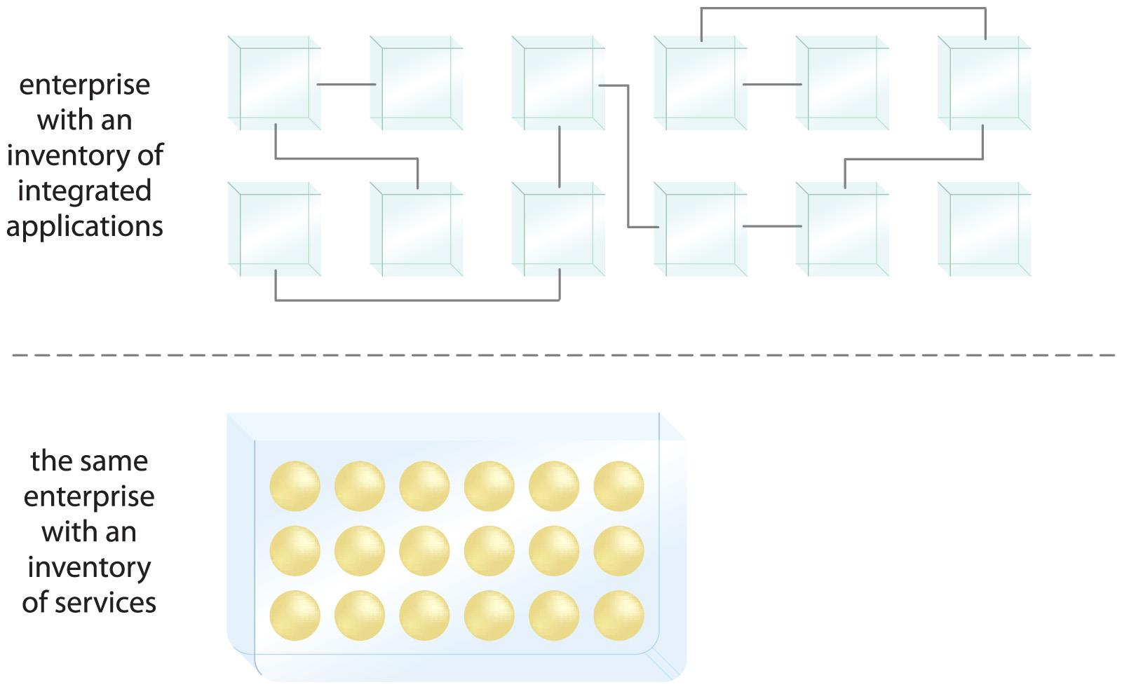
Decreased IT Burden
Reduced Waste and Redundancy
Reduced Size and operational cost
Notes:
First something about me
I spent 8 years studying at Deakin and I currently work for IBM Research
I am a research software engineer and among things I contriubte to scientific activities, patens , develop software and lead client engagements

Slide 20
Take Home
SOA is a distributed technology architectural model with distinct characteristics in support of realizing service- orientation
Service orientation is achieved by the application of service-orientation principles to the definition of services
The SOA ‘target state’ is an inventory of agnostic services that can be composed to achieve a diverse set of business process automation
SOA Promotes organizational agility and better alignment between technology and business processes
Notes:
Want to use block chain
To redefine trust
In order to empower people
To reinvent economies

Slide 21
Readings
Thomas Erl, Principles of Service Design - Chapter 3 Service Oriented Computing and SOA (hardcopy available in library)
M Rosen, Applied SOA : Service-oriented Architecture and Design Strategies - Chapter 1 Realizing the promise of SOA (eBook available through library)
Notes:
So This is my current research focus, both scientifically and also from an industry persespecitve

Slide 22
Any Questions?
Notes:
Want to use block chain
To redefine trust
In order to empower people
To reinvent economies

